Slide 1


Rohit Chauhan
12/02/2024

Slide 2

Outline
Executive Summary
Introduction
Methodology
Results
Conclusion

Slide 3
Executive Summary
Summary of Methodologies
The research attempts to identify the factors for a successful rocket landing. To make this determination, the following methodologies were used:
Collect data using SpaceX REST API and web scraping techniques
Wrangle data to create a success/fail outcome variable
Explore data with data visualization techniques, considering the following factors: payload, launch site, flight number, and yearly trend
Analyze the data with SQL, calculating the following statistics: total payload, payload range for successful launches, and total # of successful and failed outcomes
Explore launch site success rates and proximity to geographical markers
Visualize the launch sites with the most success and successful payload ranges
Build models predict landing outcomes using logistic regression, support vector machine (SVM), decision tree, and K-nearest neighbor (KNN)

Slide 4
Results-
Exploratory Data Analysis:
Launch success has improved over time
KSC LC-39A has the highest success rate among landing sites
Orbits ES-L1, GEO, HEO, and SSO have a 100% success rate
Visualization/Analytics:
Most launch sites are near the equator, and all are close to the coast
Predictive Analytics:
All models performed similarly on the test set. The decision tree model slightly outperformed

Slide 5
Introduction
Background-
SpaceX, a leader in the space industry, strives to make space travel affordable for everyone. Its accomplishments include sending spacecraft to the international space station, launching a satellite constellation that provides internet access, and sending manned missions to space. SpaceX can do this because the rocket launches are relatively inexpensive ($62 million per launch) due to its novel reuse of the first stage of its Falcon 9 rocket. Other providers, which are not able to reuse the first stage, cost upwards of $165 million each. By determining if the first stage will land, we can determine the price of the launch. To do this, we can use public data and machine learning models to predict whether SpaceX –or a competing company –can reuse the first stage.
Explore-
How payload mass, launch site, number of flights, and orbits affect first-stage landing success
Rate of successful landings over time
Best predictive model for successful landing (binary classification)

Slide 6

Section 1

Slide 7
Methodology
Steps
Collect data using SpaceX REST API and web scraping techniques
Wrangle data –by filtering the data, handling missing values, and applying one hot encoding –to prepare the data for analysis and modeling
Explore data via EDA with SQL and data visualization techniques
Visualize the data using Folium and Plotly Dash
Build models to predict landing outcomes using classification models. Tune and evaluate models to find the best model and parameters

Slide 8
Data Collection - API
Steps
Request data from SpaceX API (rocket launch data)
Decode response using .json() and convert to a data frame using .json_normalize()
Request information about the launches from SpaceX API using custom functions
Create a dictionary from the data
Create a dataframe from the dictionary
Filter data frame to contain only Falcon 9 launches
Replace missing values of Payload Mass with calculated .mean()
Export data to CSV file
https://github.com/Rohit1999025/IBM_Capstone_project

Slide 9
Data Collection - Scraping
Steps
Request data(Falcon 9 launch data) from Wikipedia
Create a Beautiful Soup object from the HTML response
Extract column names from the HTML table header
Collect data from parsing HTML tables
Create a dictionary from the data
Create dataframe from the dictionary
Export data to CSV file data file
https://github.com/Rohit1999025/IBM_Capstone_project

Slide 10
Data Wrangling
In the data set, there are several different cases where the booster did not land successfully. Sometimes a landing was attempted but failed due to an accident; for example, True Ocean means the mission outcome was successfully landed in a specific region of the ocean while False Ocean means the mission outcome was unsuccessfully landed in a specific region of the ocean. True RTLS means the mission outcome was successfully landed on a ground pad False RTLS means the mission outcome was unsuccessfully landed on a ground pad. True ASDS means the mission outcome was successfully landed on a drone ship False ASDS means the mission outcome was unsuccessfully landed on a drone ship. We mainly convert those outcomes into Training Labels with “1” meaning the booster successfully landed, and “0” meaning it was unsuccessful.
https://github.com/Rohit1999025/IBM_Capstone_project

Slide 11
EDA with Data Visualization
Charts:
Flight Number vs. Payload Mass Flight Number vs. Launch Site Payload Mass vs. Launch Site Orbit Type vs. Success Rate Flight Number vs. Orbit Type Payload Mass vs Orbit Type Success Rate Yearly Trend
Scatter plots show the relationship between variables. If a relationship exists, they could be used in a machine learning model. Bar charts show comparisons among discrete categories. The goal is to show the relationship between the specific categories being compared and a measured value. Line charts show trends in data over time (time series).
https://github.com/Rohit1999025/IBM_Capstone_project

Slide 12
EDA with SQL
Queries
Display:
Names of unique launch sites
5 records where the launch site begins with ‘CCA’
Total payload mass carried by boosters launched by NASA (CRS)
Average payload mass carried by booster version F9 v1.1.
List:
Date of first successful landing on the ground pad
Names of boosters which had success landing on drone ships and have payload mass greater than 4,000 but less than 6,000
Total number of successful and failed missions
Names of booster versions that have carried the max payload
Failed landing outcomes on the drone ship, their booster version, and launch site for the months in the year 2015
Count of landing outcomes between 2010-06-04 and 2017-03-20 (desc)
https://github.com/Rohit1999025/IBM_Capstone_project

Slide 13
Build an Interactive Map with Folium
Markers Indicating Launch Sites
Added a blue circle at NASA Johnson Space Center's coordinate with a popup label showing its name using its latitude and longitude coordinates
Added red circles at all launch site coordinates with a popup label showing its name using its name using its latitude and longitude coordinates
Map with Folium
Colored Markers of Launch Outcomes
Added colored markers of successful(green) and unsuccessful (red) launches at each launch site to show which launch sites have high success rates
Distances Between a Launch Site to Proximities
Added colored lines to show the distance between launch site CCAFS SLC-40 and its proximity to the nearest coastline, railway, highway, and city

Slide 14
Build a Dashboard with Plotly Dash
Dropdown List with Launch Sites
Allow user to select all launch sites or a certain launch site
Slider of Payload Mass Range
Allow user to select payload mass range
Pie Chart Showing Successful Launches
Allow user to see successful and unsuccessful launches as a percent of the total
Scatter Chart Showing Payload Mass vs. Success Rate by Booster Version
Allow user to see the correlation between Payload and Launch Success

Slide 15
Predictive Analysis (Classification)
Charts
Create NumPy array from the Class column
Standardize the data with StandardScaler. Fit and transform the data.
Split the data using train_test_split
Create a GridSearchCV object with cv=10 for parameter optimization
Apply GridSearchCV on different algorithms: logistic regression (LogisticRegression()), support vector machine (SVC()), decision tree (DecisionTreeClassifier()), K-Nearest Neighbor (KNeighborsClassifier())
Calculate accuracy on the test data using .score() for all models
Assess the confusion matrix for all models
Identify the best model using Jaccard_Score, F1_Score and Accuracy

Slide 16
Results
Exploratory data analysis results
Interactive analytics demo in screenshots
Predictive analysis results

Slide 17

Section 2

Slide 18
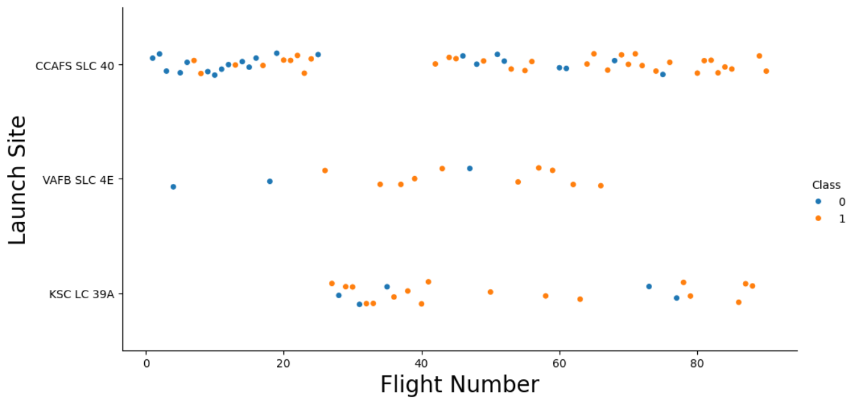
Flight Number vs. Launch Site
Exploratory Data Analysis
Earlier flights had a lower success rate (blue = fail)
Later flights had a higher success rate (orange = success)
Around half of launches were from the CCAFS SLC 40 launch site
VAFB SLC 4E and KSC LC 39A have higher success rates
We can infer that new launches have a higher success rate

Slide 19
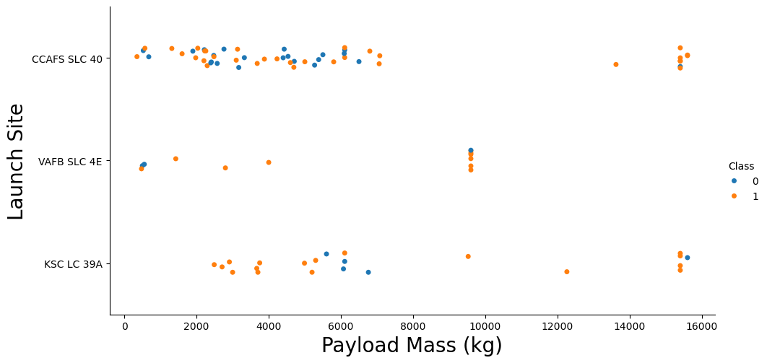
Payload vs. Launch Site
Exploratory Data Analysis
Typically, the higher the payload mass (kg), the higher the success rate
Most launches with a payload greater than 7,000 kg were successful
KSC LC 39A has a 100% success rate for launches less than 5,500 kg
VAFB SKC 4E has not launched anything greater than ~10,000 kg

Slide 20
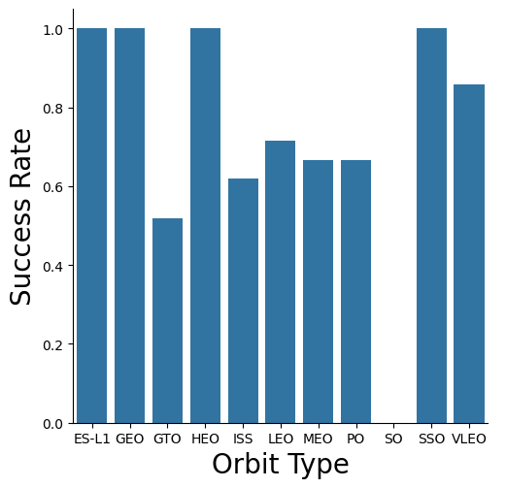
Success Rate vs. Orbit Type
Exploratory Data Analysis
100% Success Rate: ES-L1, GEO, HEO and SSO
50%-80% Success Rate: GTO, ISS, LEO, MEO, PO
0% Success Rate: SO

Slide 21
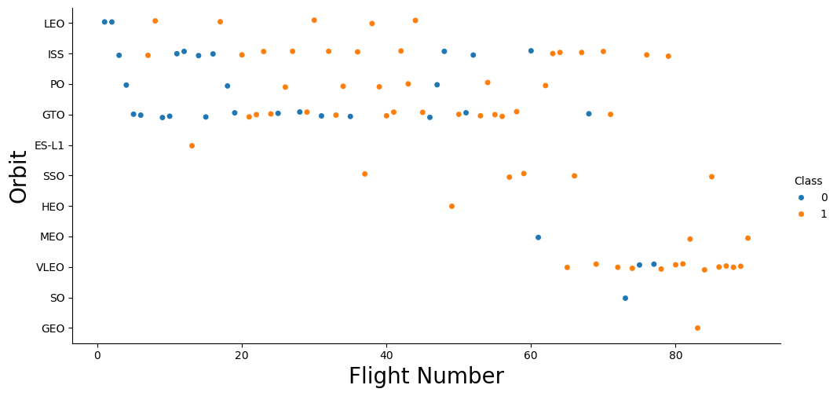
Flight Number vs. Orbit Type
Exploratory Data Analysis
The success rate typically increases with the number of flights for each orbit
This relationship is highly apparent for the LEO orbit
The GTO orbit, however, does not follow this trend

Slide 22
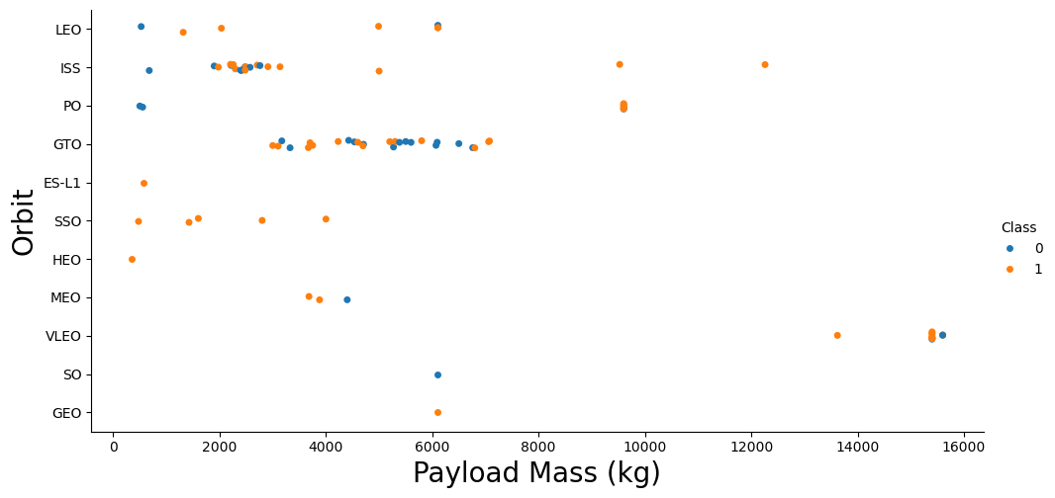
Payload vs. Orbit Type
Exploratory Data Analysis
Heavy payloads are better
with LEO, ISS, and PO orbits
The GTO orbit has mixed
success with heavier payloads

Slide 23
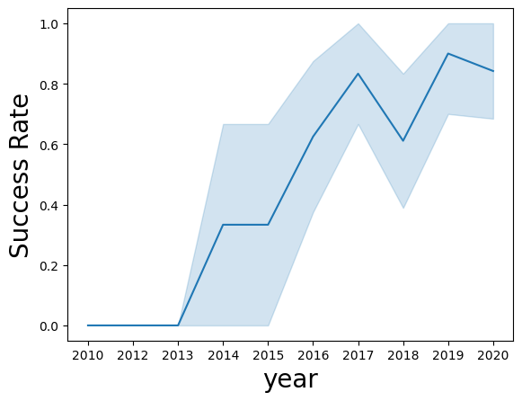
Launch Success Yearly Trend
Exploratory Data Analysis
The success rate improved from 2013-2017 and 2018-2019
The success rate decreased from 2017-2018 and from 2019-2020
Overall, the success rate has improved since 2013

Slide 24
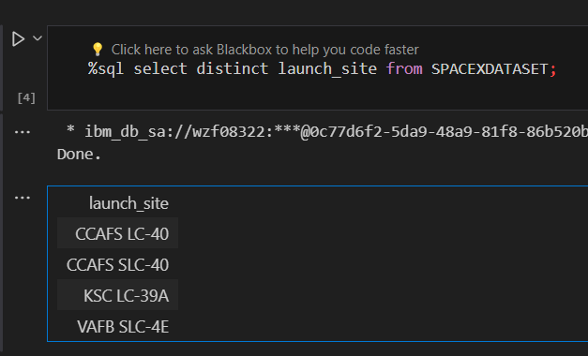
All Launch Site Names
Launch Site Names
CCAFS LC-40
CCAFS SLC-40
KSC LC-39A
VAFB SLC-4E

Slide 25
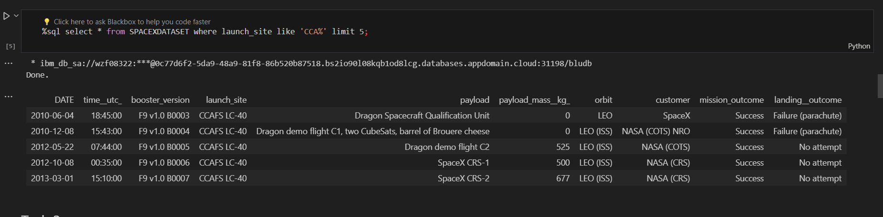
Launch Site Names Begin with 'CCA'
Displaying 5 records where launch sites begin with the string 'CCA'.

Slide 26
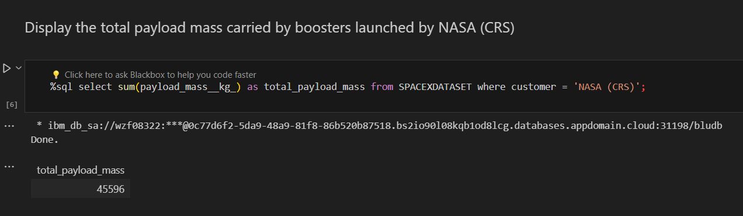
Total Payload Mass
Displaying the total payload mass carried by boosters launched by NASA (CRS).

Slide 27
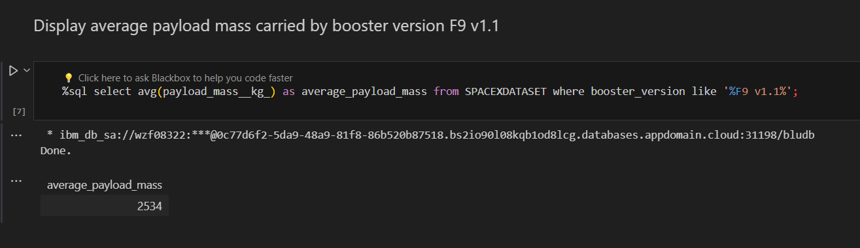
Average Payload Mass by F9 v1.1
2,928 kg (average) carried by booster version F9 v1.1
Average Payload Mass

Slide 28
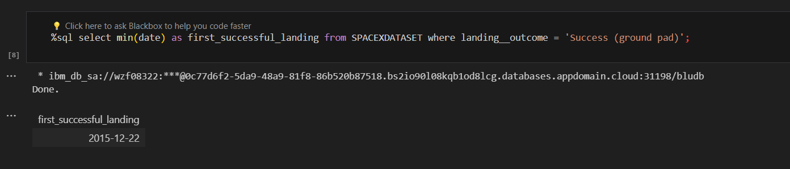
First Successful Ground Landing Date
1stSuccessful Landing in Ground Pad
12/22/2015

Slide 29
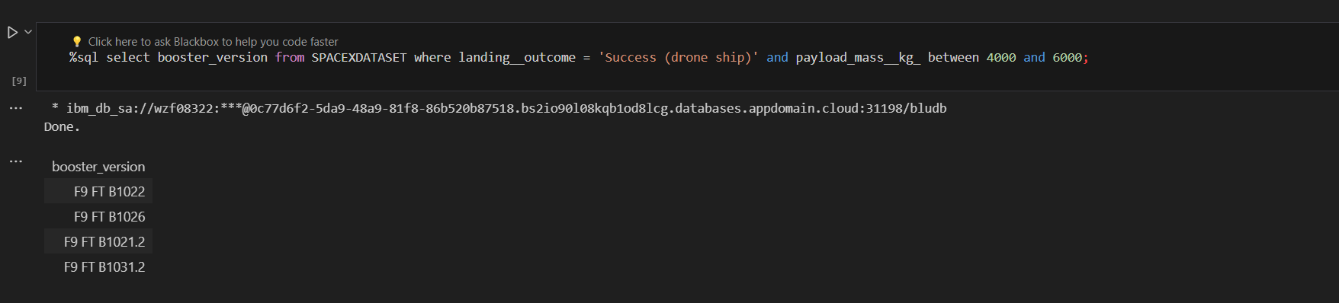
Successful Drone Ship Landing with Payload between 4000 and 6000
Booster Drone Ship Landing
Booster mass greater than 4,000 but less than 6,000
•JSCAT-14, JSCAT-16, SES-10, SES-11 / EchoStar 105

Slide 30
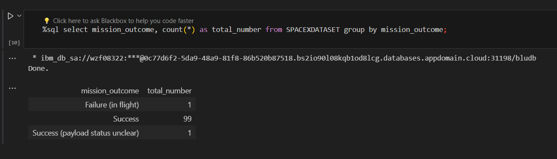
Total Number of Successful and Failure Mission Outcomes
1 Failure in Flight
99 Success
1 Success (payload status unclear)

Slide 31
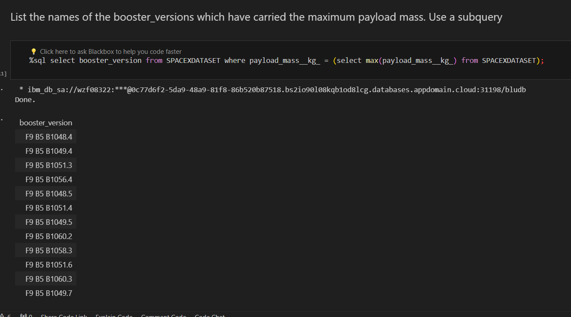
Boosters Carried Maximum Payload
F9 B5 B1048.4
F9 B5 B1049.4
F9 B5 B1051.3
F9 B5 B1056.4
F9 B5 B1048.5
F9 B5 B1051.4
F9 B5 B1049.5
F9 B5 B1060.2
F9 B5 B1058.3
F9 B5 B1051.6
F9 B5 B1060.3
F9 B5 B1049.7

Slide 32
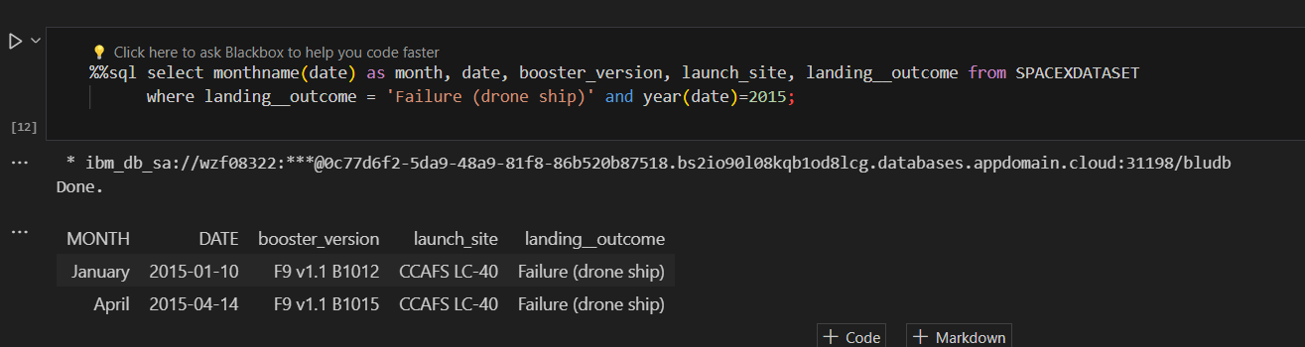
2015 Launch Records
Showing month, date, booster version, launch site and landing outcome,

Slide 33
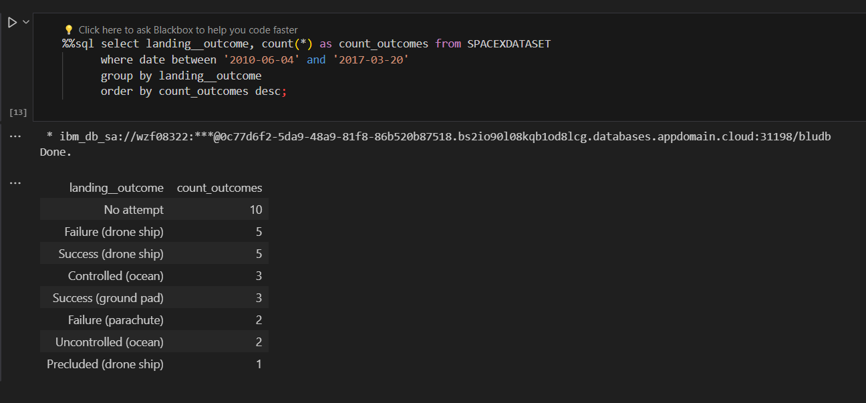
Rank Landing Outcomes Between 2010-06-04 and 2017-03-20
Ranked Descending
Count of landing outcomes between 2010-06-04 and 2017-03-20 in descending order

Slide 34

Section 3

Slide 35
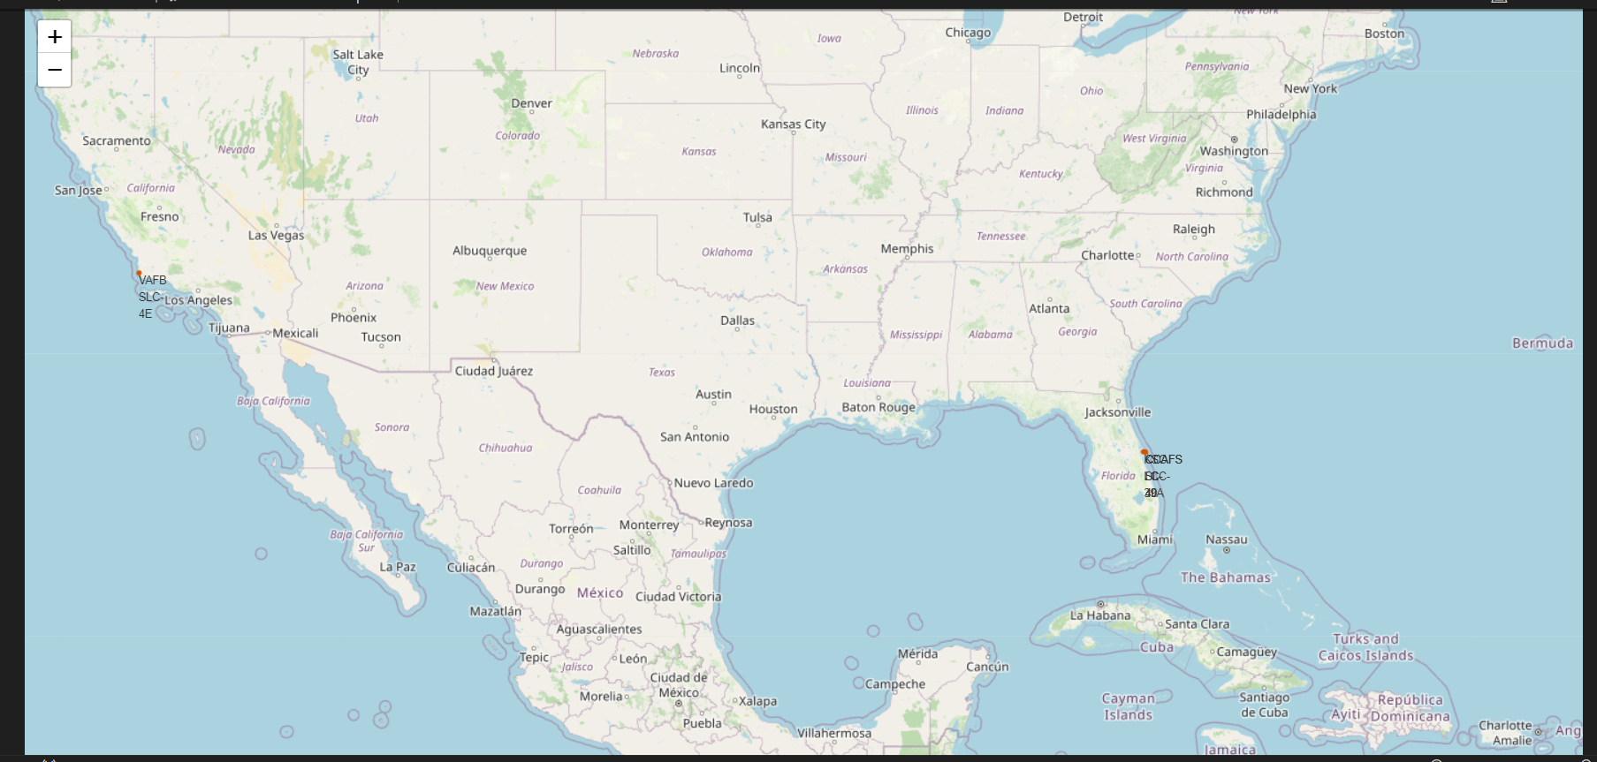
Launch Sites
With Markers
Near Equator: the closer the launch site is to the equator, the easier it is to launch to equatorial orbit, and the more help you get from Earth’s rotation for a prograde orbit. Rockets launched from sites near the equator get an additional natural boost-due to the rotational speed of the earth –that helps save the cost of putting in extra fuel and boosters. boost- due

Slide 36
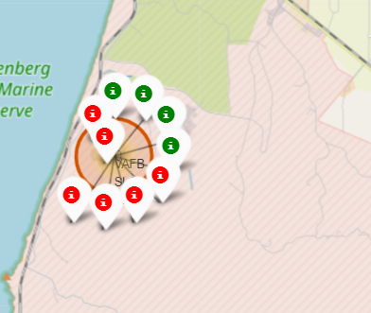
Colour-labeled launch records on the map
• From the colour-labeled markers we should be able to easily identify which launch sites have relatively high success rates.
Green Marker = Successful Launch
Red Marker = Failed Launch
• Launch Site KSC LC-39A has a very high Success Rate.

Slide 37
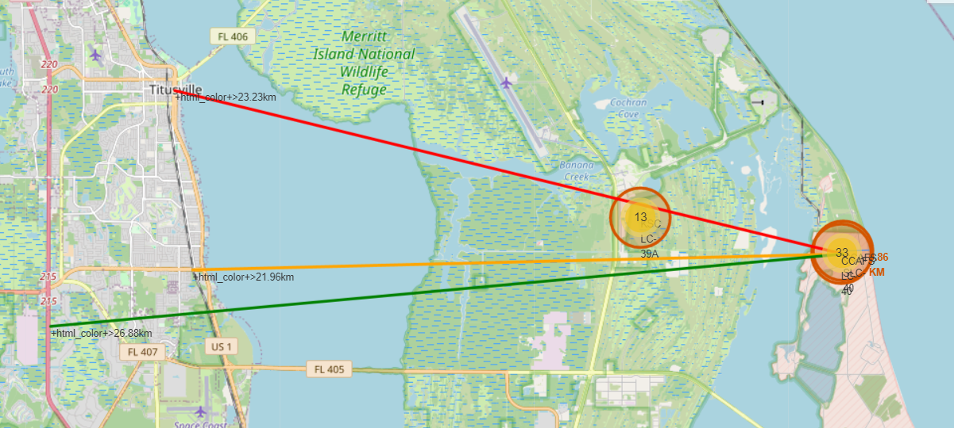
Distance from the launch site KSC LC-39A to its proximities
CCAFS SLC-40
Coasts: help ensure that spent stages dropped along the launch path or failed launches don't fall on people or property.
Safety / Security: There needs to be an exclusion zone around the launch site to keep unauthorized people away and keep people safe.
Transportation/Infrastructure and Cities: need to be away from anything a failed launch can damage, but still close enough to roads/rails/docks to be able to bring people and material to or from it in support of launch activities.

Slide 38

Section 4

Slide 39
Launch success count for all sites
The chart clearly shows that from all the sites, KSC LC-39A has the most successful launches.

Slide 40
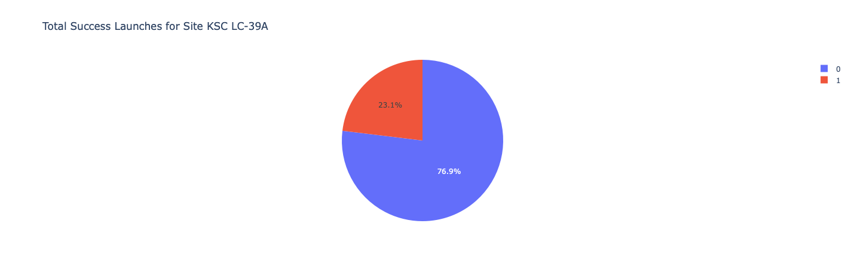
Launch site with highest launch success ratio
KSC LC-39A has the highest launch success rate (76.9%) with 10 successful and only 3 failed landings

Slide 41
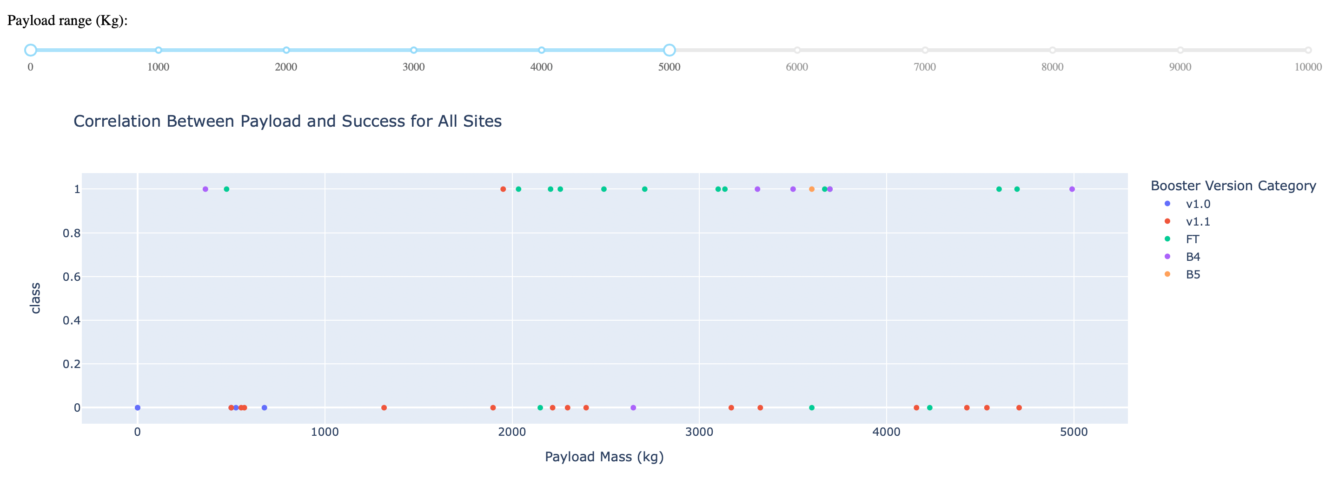
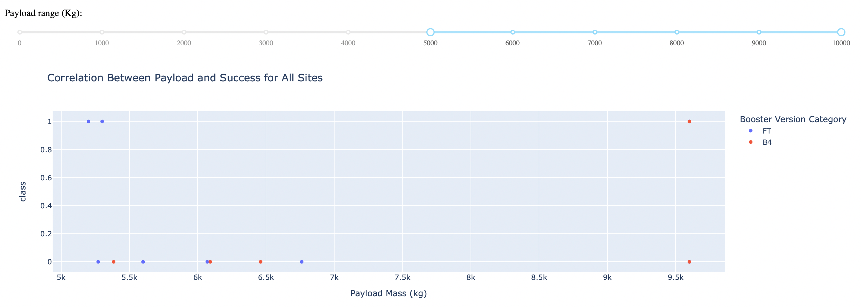
Payload Mass vs. Launch Outcome for all sites
The charts show that payloads between 2000 and 5500 kg have the highest success rate.

Slide 42

Section 5

Slide 43
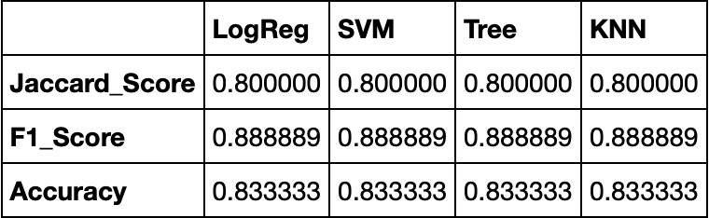
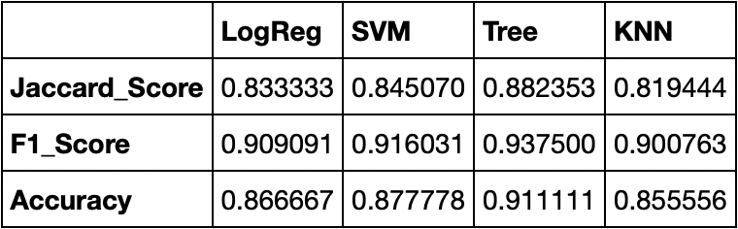
Classification Accuracy
Scores and Accuracy of the Test Set
Explanation:
Based on the scores of the Test Set, we can not confirm which method performs best.
Same Test Set scores may be due to the small test sample size (18 samples). Therefore, we tested all methods based on the whole Dataset.
The scores of the whole Dataset confirm that the best model is the Decision Tree Model. This model has not only higher scores but also the highest accuracy.
Scores and Accuracy of the Entire Data Set

Slide 44
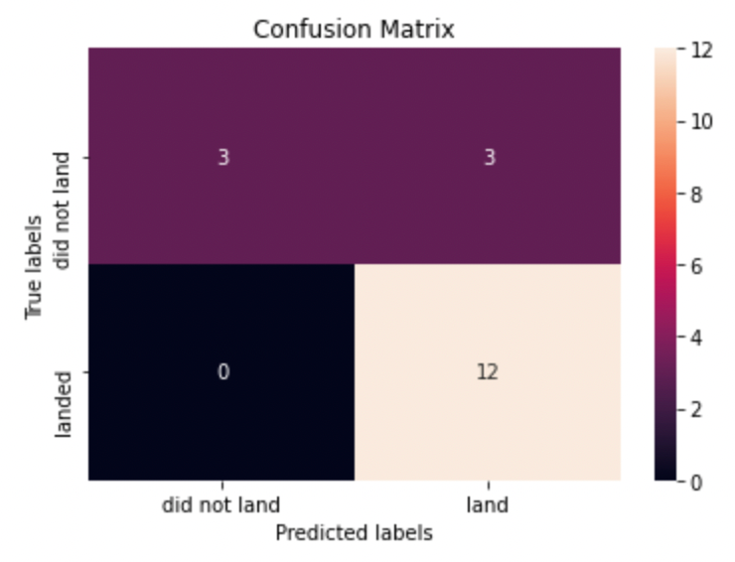
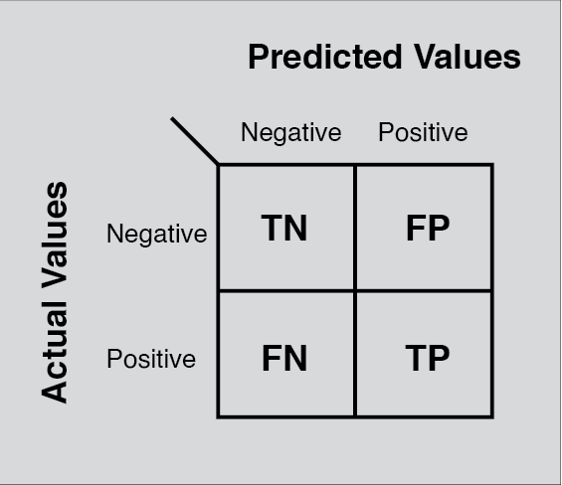
Confusion Matrix
• Examining the confusion matrix, we see that logistic regression can distinguish between the different classes. We see that the major problem is false positives.

Slide 45
Conclusions
Model Performance: The models performed similarly on the test set with the decision tree model slightly outperforming
Equator: Most of the launch sites are near the equator for an additional natural boost -due to the rotational speed of earth –which helps save the cost of putting in extra fuel and boosters
Coast: All the launch sites are close to the coast
Launch Success: Increases over time
KSC LC-39A: Has the highest success rate among launch sites. Has a 100% success rate for launches less than 5,500 kg
Orbits: ES-L1, GEO, HEO, and SSO have a 100% success rate
Payload Mass: Across all launch sites, the higher the payload mass (kg), the higher the success rate

Slide 46


